Slide 1
Mental Health on Social Media
Connor Check, Maitrey Phatak

Slide 2
Introduction and Motivation
Social media usage has increased dramatically over the last decade.
More and more people are sharing their struggles online within specific communities.
How language differs between these communities can tell us about the state of mental health online.
Our goal: Use NLP features to classify posts into their respective mental health subreddits and explore differences in language usage between communities.

Slide 3
Introduction and Motivation
Key Questions
Can NLP features accurately classify posts into their respective mental health subreddits?
Which linguistic features are most informative for differentiating communities?
Do posts within the same subreddit share similar language patterns, and how do these patterns differ across subreddits?

Slide 4

Dataset Used
Reddit Mental Health Dataset
This dataset contains posts from 28 subreddits (15 mental health support groups) from 2018-2020.
57727 Samples x 346 Features
Low, D. M., Rumker, L., Torous, J., Cecchi, G., Ghosh, S. S., & Talkar, T. (2020). Natural Language Processing Reveals Vulnerable Mental Health Support Groups and Heightened Health Anxiety on Reddit During COVID-19: Observational Study. Journal of medical Internet research, 22(10), e22635.

Slide 5
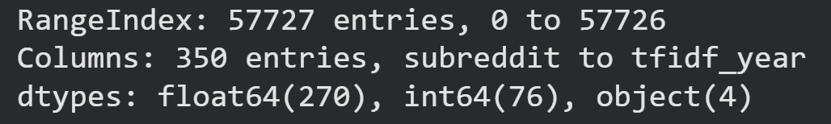
Data Preprocessing
Data in the form of TF-IDF and readability scores (floats)
Data was clean but with a lot of features

Slide 6
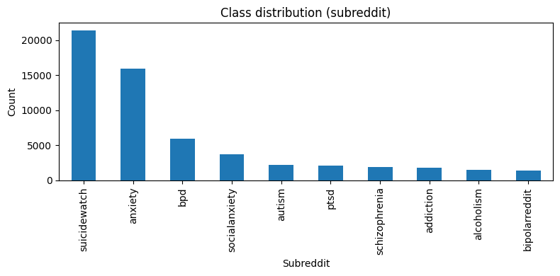
Data Visualizations
Class distribution
  Uneven

Slide 7
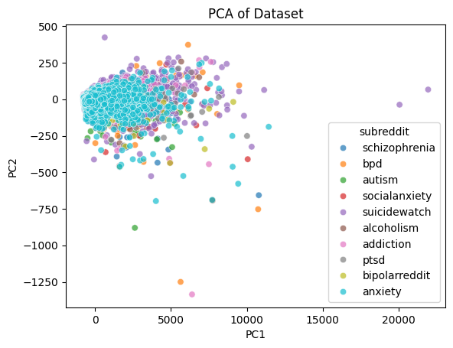
Data Visualizations
Dimension reduction through Principal Component Analysis (PCA)
Clumping -> Words shared across communities

Slide 8
Modeling Approach
Basic NLP with:
Multinomial Logistic Regression:
Treats each word or feature as a signal and predicts the probability of a post belonging to each subreddit, effectively modeling how different words contribute to membership.
Support Vector Machine:
Finds the planes in the high-dimensional feature space that best separate posts from different subreddits.

Slide 9
Hyperparameters
Train size: 40408
Val size: 8659
Test size: 8660
SVM:
Class Weight = "balanced"
Calibration method = "sigmoid"
Calibration cv = 3
Regression:
Class Weight = "balanced"
Multi Class = "multinomial"
Solver = "saga"
Max Iterations = 1000

Slide 10
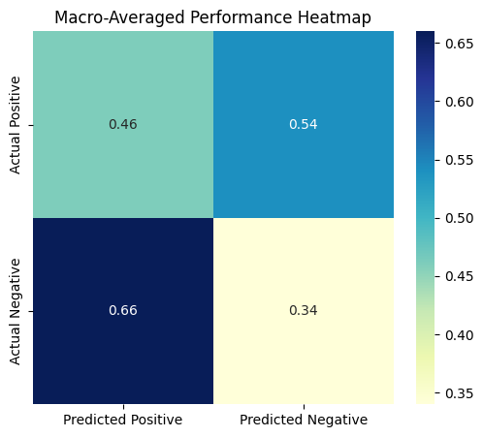
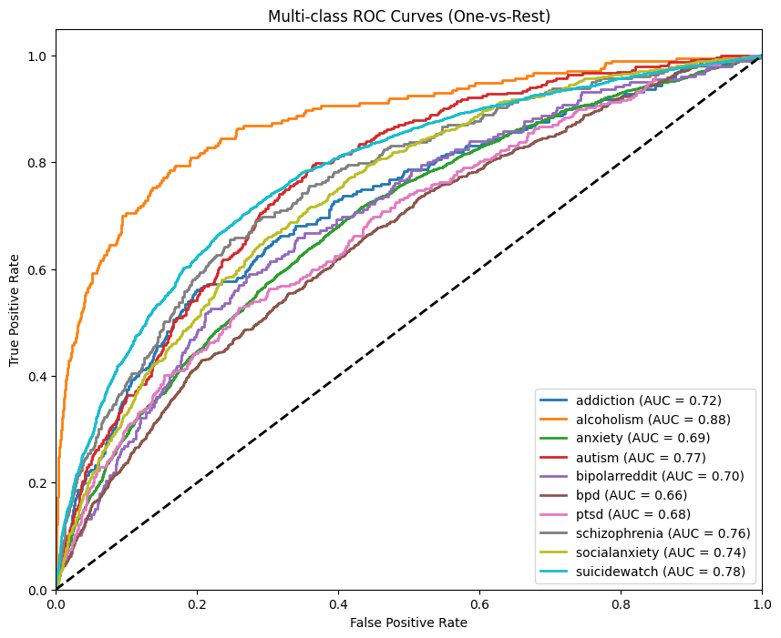
Model Performance
Regression
Validation accuracy: 0.33
Test accuracy: 0.34

Slide 11
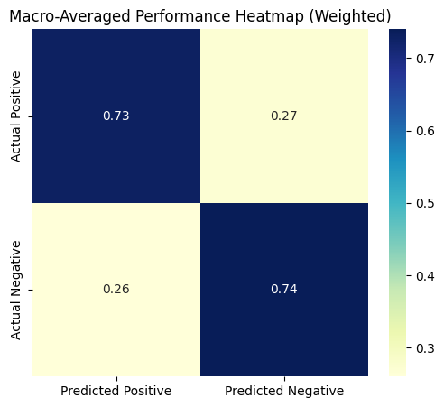
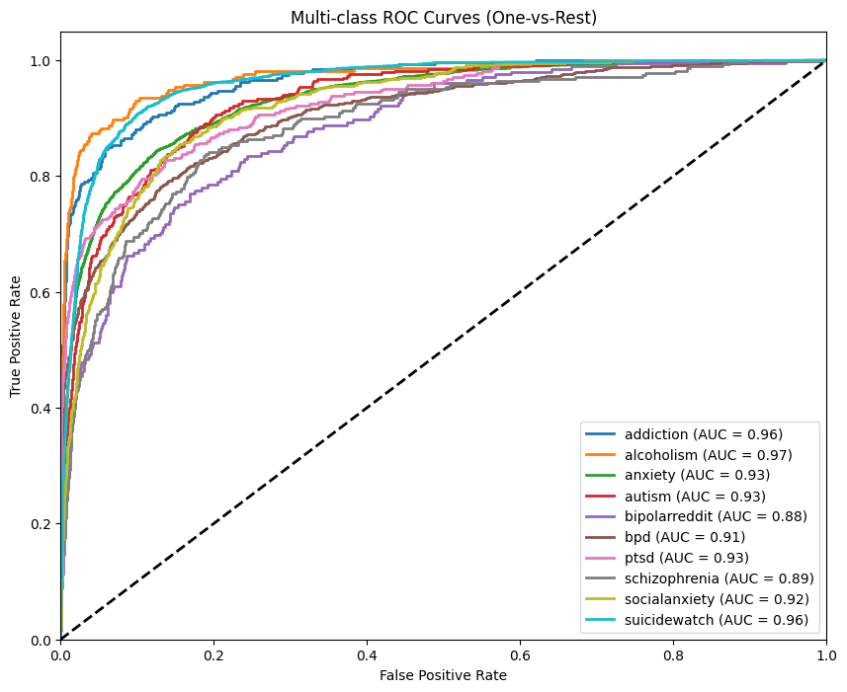
Model Performance
Support Vector
Validation accuracy: 0.74
Test accuracy: 0.74

Slide 12
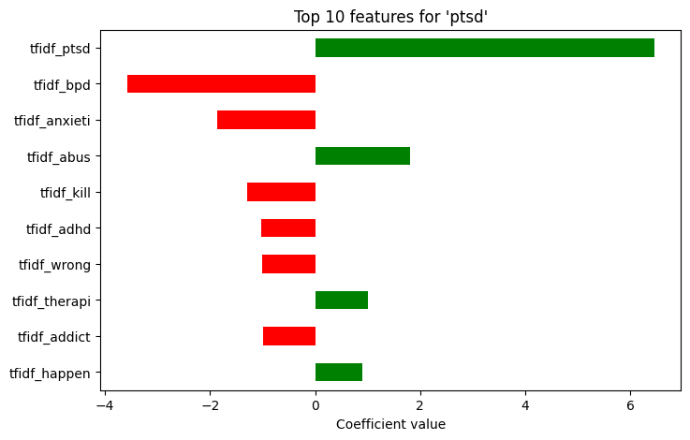
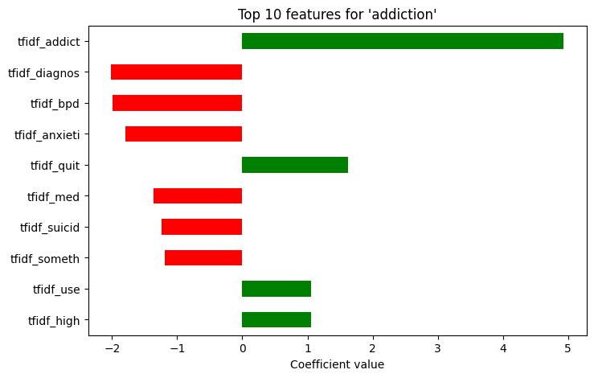
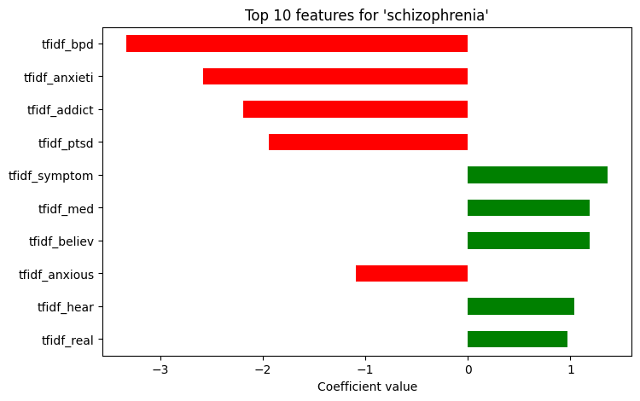
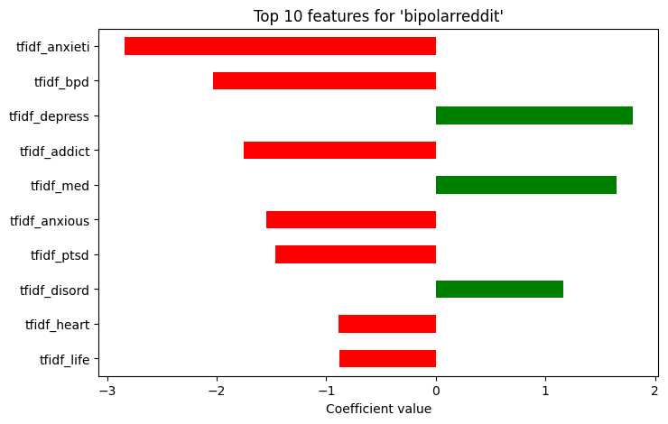
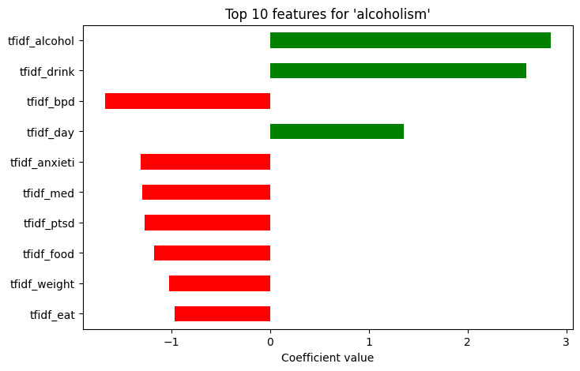
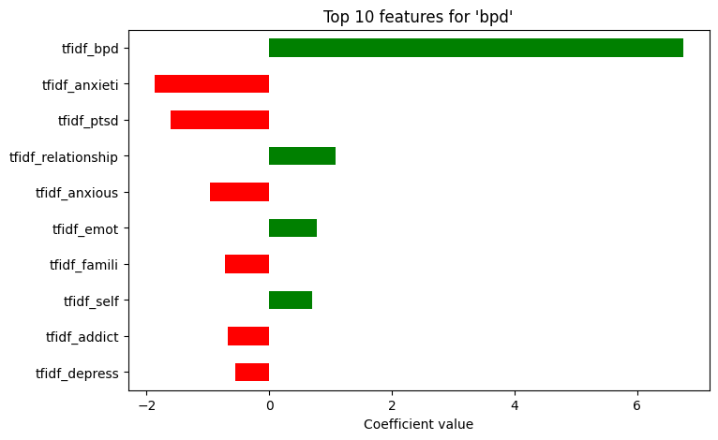
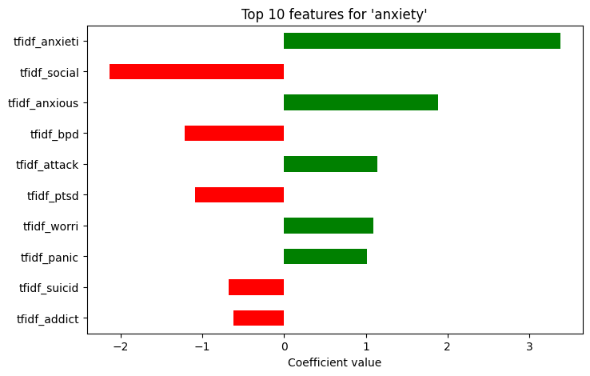
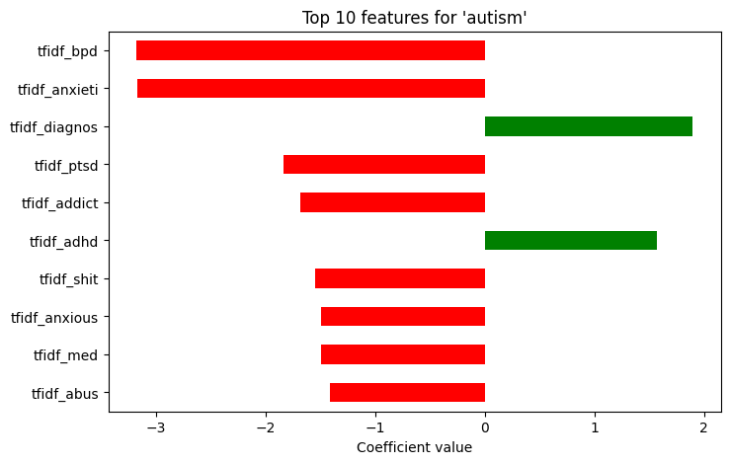
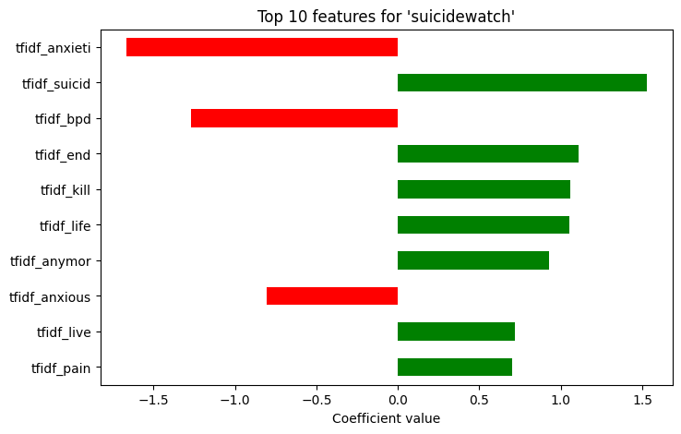
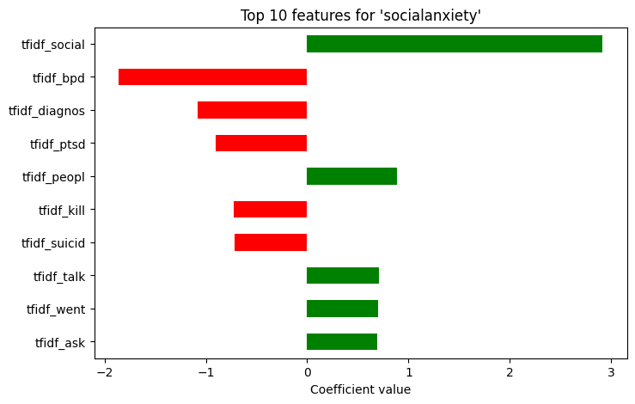
Feature Relevance
Mainly determined by a few specific keywords (BPD, Schizophrenic, Social, etc.)

Slide 13
Limitations
The large amount of features prevented a lot of analysis: we weren’t able to look for relations between features
Class overlap: it would have been better to pull from separate websites as there is likely some user overlap

Slide 14
Conclusion
We modeled a regression model and a SVM on a dataset that related word choice in posts with different subreddits focused on mental health.
Through this we were able to analyze the commonalities and differences in language shared between groups.
We hope that this will aid in mental health support and community building.

